Slide 1
Role of policy and community engagements in biodiversity conservation in africa
N. O. Oguge, Ph.D.
Professor of Environmental Policy
Faculty of Law
University of Nairobi

Slide 2
Direct drivers growing in intensity
Most direct drivers of degradation in ecosystem services remain constant or are growing in intensity in most ecosystems

Slide 3
Food
Food
Rhino horn
DUST
Fisheries
Consider Teleconnections and impacts on Africa’s natural resources
International trade policies
Habitat conversion for food, renewable energy, Biodiversity loss
Consider ecosystem service flows (local, national, global). Consider also impact of land grabs on biodiversity…

Slide 4
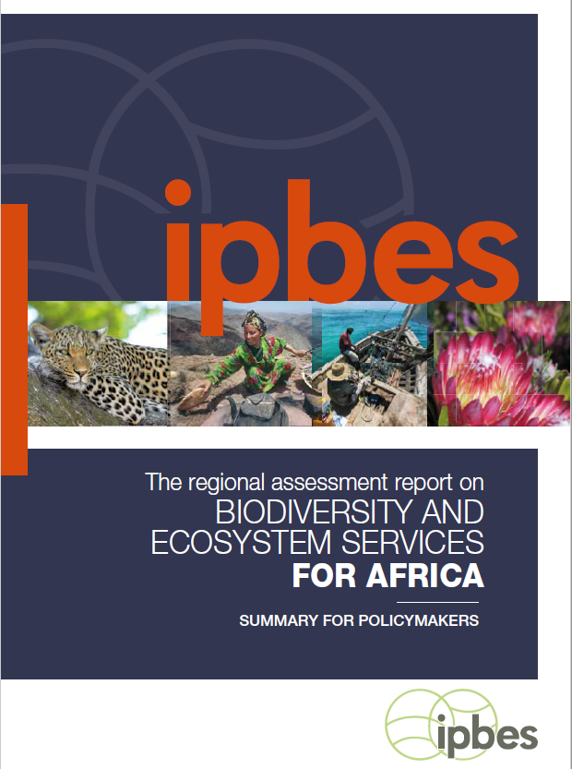
The Process
Assessment requested by governments in 2015 and conducted over 3 years
143 leading international experts (mainly from Africa) from 31 countries
Number of Countries: 31
Used 2359 (papers, gov reports, international / regional reports and indigenous and local knowledge)
Received 3112 external review comments

Slide 5
Africa’s natural assets are unique
1.

Slide 6
Africa has extraordinary rich biodiversity and ecosystems as well as a wealth of indigenous and local knowledge. Africa is the last place on Earth with a significant assemblage of large mammals. Yet, the true value of nature’s contributions to human well-being is still underappreciated in decision-making processes.

Slide 7
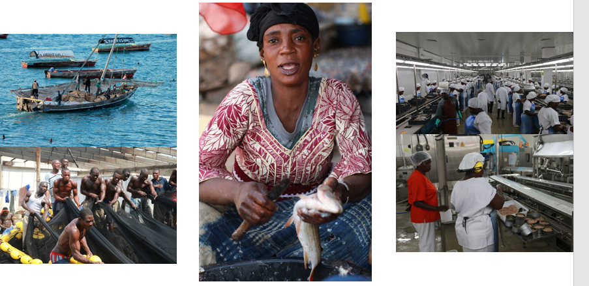
Africa’s extraordinary richness in biodiversity and ecosystem services, and its wealth of indigenous and local knowledge, comprise strategic assets for sustainable development in the region.
Notes:
Africa has important genetic diversity strengthens the resilience of African food systems and communities. It can be seen in the livestock breeds and crop varieties, which were essentially bred from their wild relatives.

Slide 8
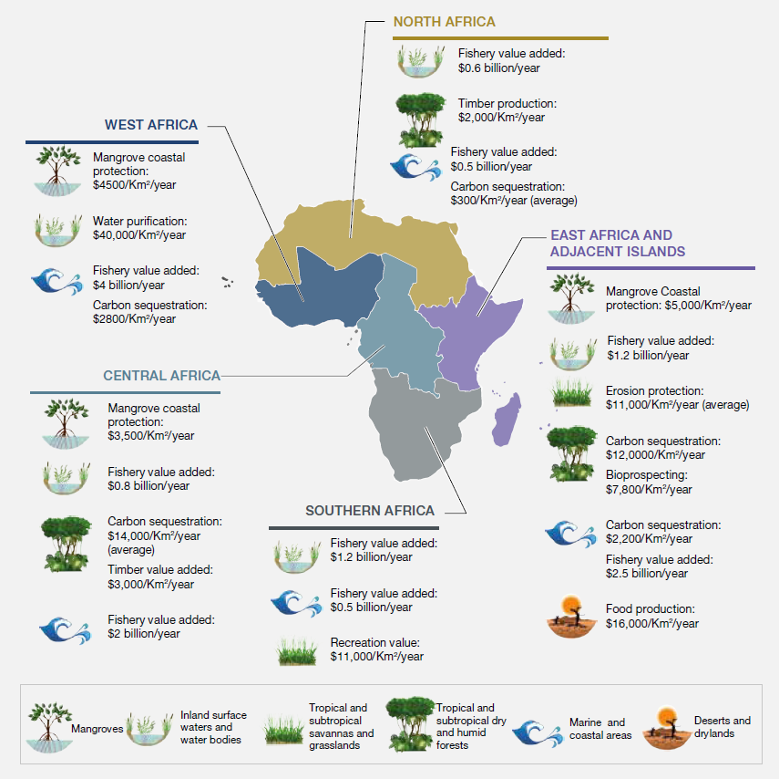
Africa’s richness in biodiversity and ecosystem services underestimated

Slide 9
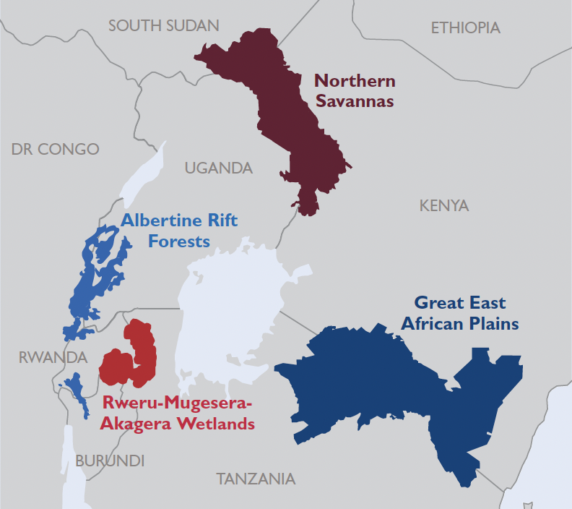
THE FOUR LANDSCAPES
Notes:
[Note the 4 landscape names…]
These landscapes were chosen – in partnership with the EAC and Partner States -- based on their economic and cultural importance, as well as their unique species and habitats.
[Maybe highlight 1 or 2 distinguishing features/protected areas/wildlife for each landscape]

Slide 10
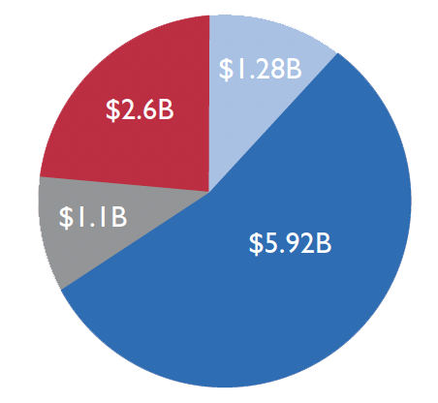
Nature's contribution to global economy > $125 trillion/year Landscapes' contribution to EAC economy ~$10.9 billion/year
Notes:
This value is largely from unaccounted services that we all benefit from including reducing costs of businesses.
For example, drinking water, flood protection, carbon storage and large recreational areas that support tourism.

Slide 11
Tourism only 11% of value ($1.2 billion)
Regulating services 65% of total value: ($7.04 billion)
Water flow regulation: $1.52 billion
Water quality amelioration: $2.1 million
Preventing soil erosion: $4.40 billion
Carbon storage: $1.1 billion (avoided costs of damage from climate change)
Notes:
This value is largely from unaccounted services that we all benefit from including reducing costs of businesses.
For example, drinking water, flood protection, carbon storage and large recreational areas that support tourism.

Slide 12
Key messages
Increases in protected area coverage of key biodiversity areas across all sub-regions since 1900s- still less than 50%
Alignment of many policy objectives in the region enable the development of interventions that can have multiple positive outcomes
Use of tools- e.g. scenarios and models can assist with understanding some of the trade-offs and tensions of development trajectories

Slide 13
POLICY ALIGNMENT for key policies in Africa
Notes:
One of the innovative things- aligning the Agenda 2063, with Aichi targets and the SDGs- looking at the likelihood of achieving them under different scenarios- this gives decision makers an idea of what trade-offs and synergies exist

Slide 14
POLICY ALIGNMENT for key policies in Africa

Slide 15
POLICY ALIGNMENT for key policies in Africa

Slide 16
POLICY ALIGNMENT

Slide 17
Achieving AU Agenda 2063, the SDGs, and the Aichi targets is unlikely in three out of five plausible futures considered. Of the five possible scenarios explored, two (regional sustainability and local sustainability) are identified as the most likely paths to meet Africa’s economic, social and environmental development aspirations
The Market Forces
Policy Reform
The Fortress World
Regional Sustainability
Local Sustainability
Notes:
Drivers of biodiversity loss will increase in all plausible futures considered in this assessment

Slide 18
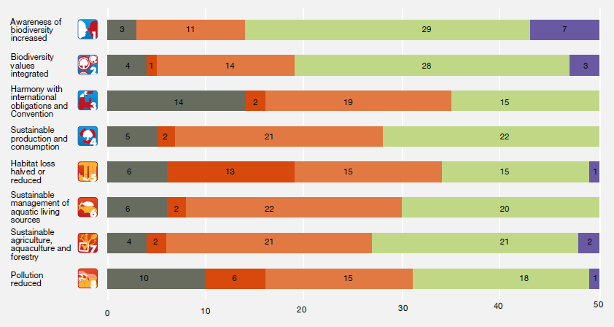

Slide 19
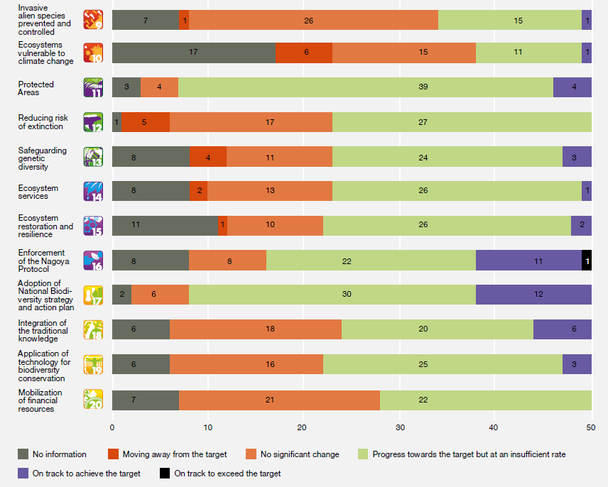

Slide 20
Africa has options
4.

Slide 21
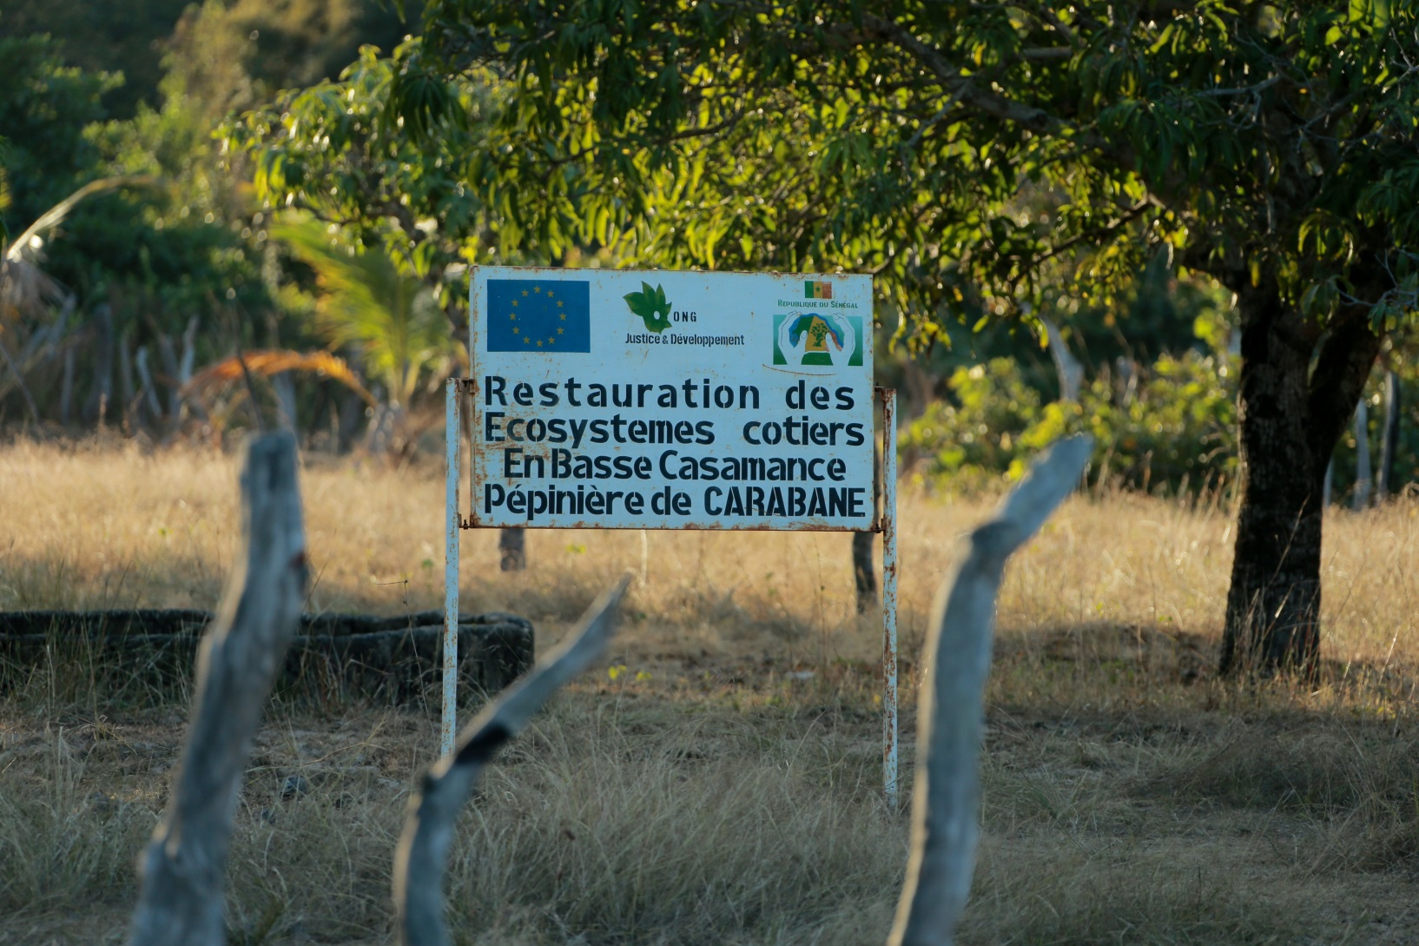
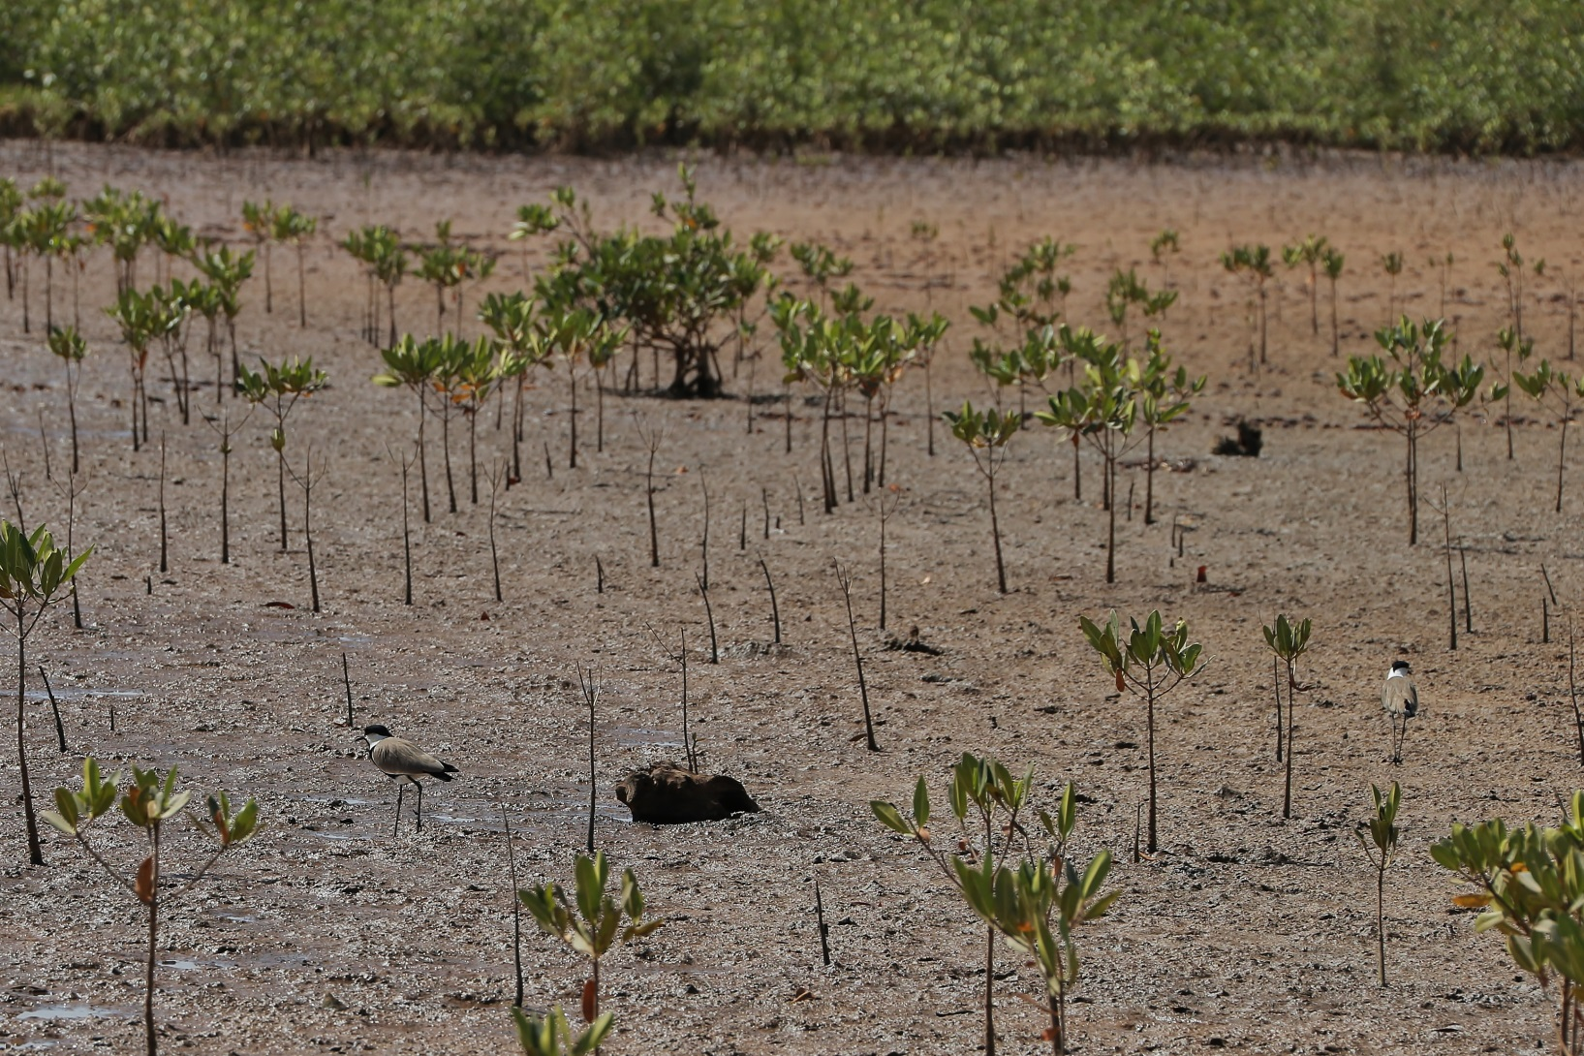
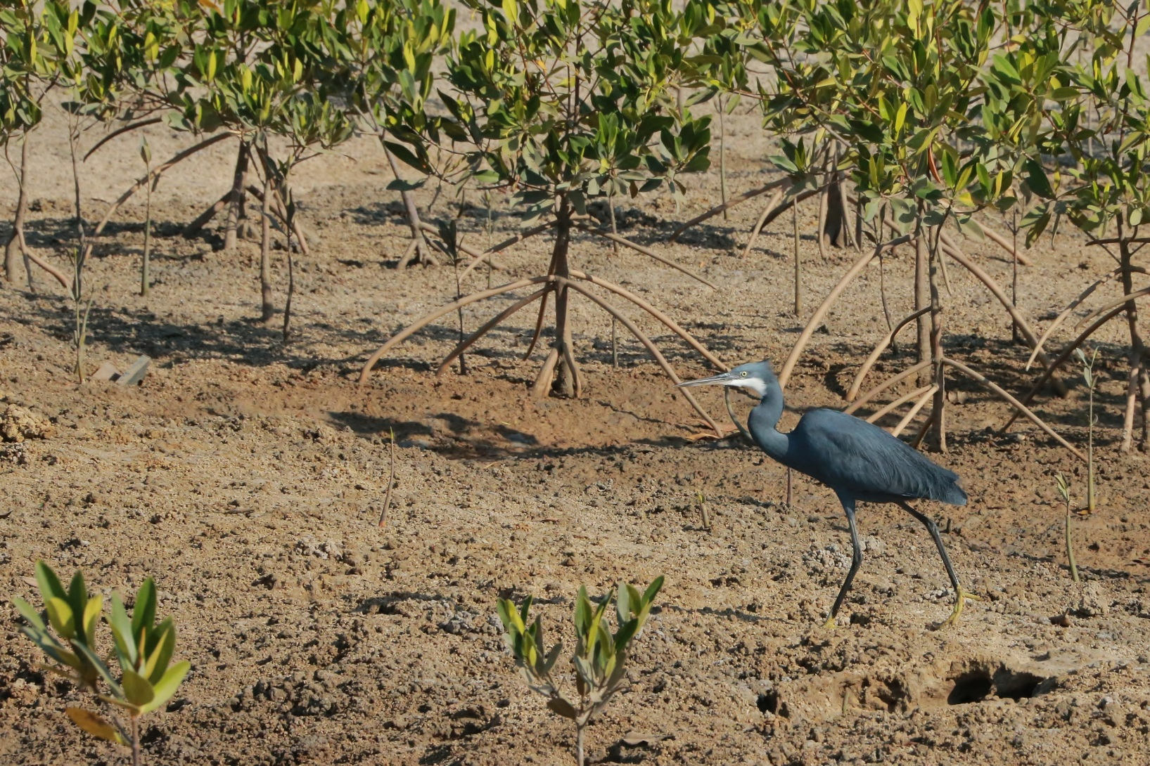
Measures taken to protect biodiversity by African Governments, such as expansion of protected areas, control of invasive alien species, restoration of ecosystems and control of invasive alien species, have already contributed to the recovery of some threatened species.
Notes:
As a strategic measure to protect them, and also the species, knowledge and genetic resources that they harbour, countries have declared 14 per cent of the continent’s land mass and 2.6 per cent of the seas as protected areas

Slide 22
Community engagements in biodiversity conservation
Community-Based Natural Resource Management (CBNRM)

Slide 23
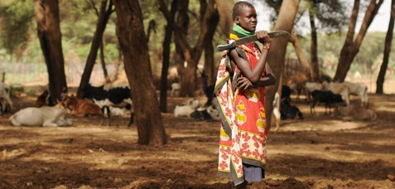
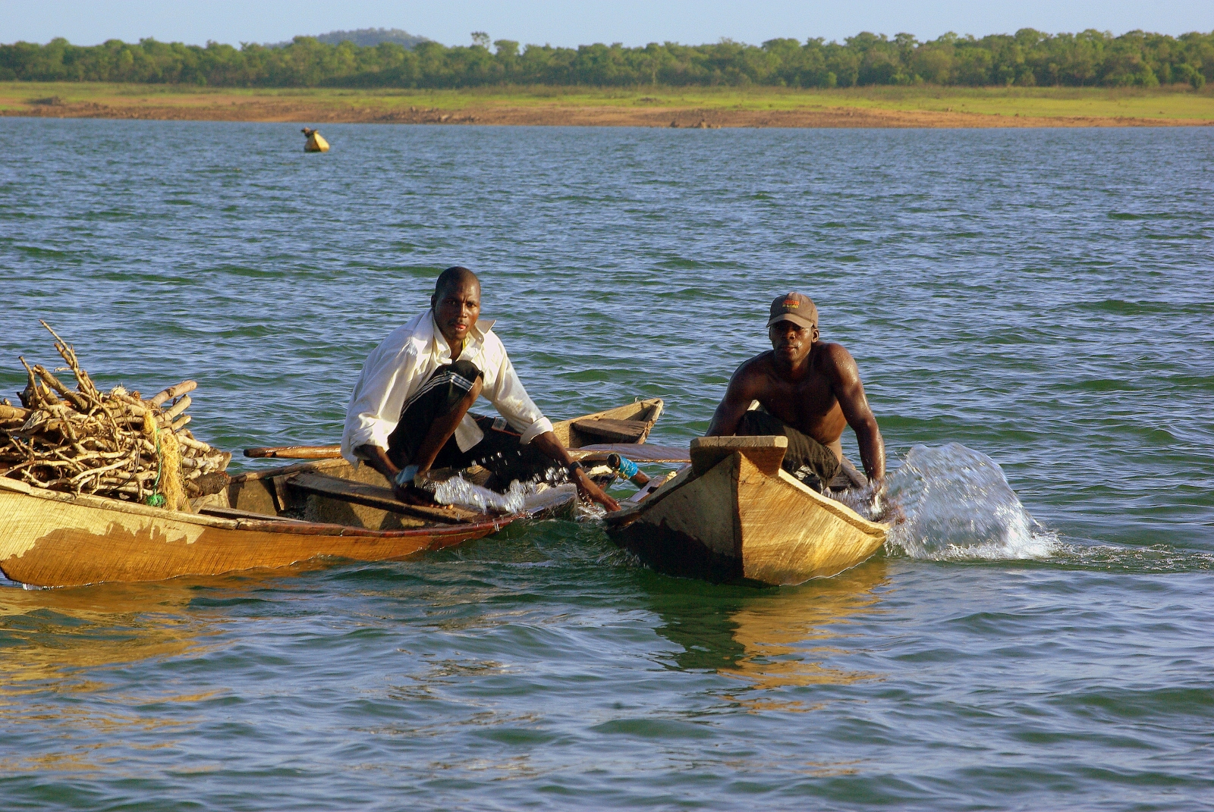
Albertine Rift Forests
Great East African Plains
Rweru-Mugesera Wetlands
Potential enterprises
sustainable silvoarable agroforestry with non-timber forest products * handicrafts * mushroom * apiary * dairy * renewable energy * eco- and cultural tourism + PES + savings & loans
Potential enterprises
sustainable silvopasture * apiary * eco- and cultural tourism * handicrafts * renewable energy * sustainable charcoal production + Biobanking (focus on endangered habitats and species) + savings & loans
Potential enterprises
Sustainable agribusinesses * eco-friendly fish processing * handicrafts, renewable energy * and eco- and cultural tourism
+ Wetlandbanking + savings & loans
Natural resources remain central to rural people’s livelihoods

Slide 24
Regional economic models consider wildlife as national government resources, while costs are borne by individual households, the outcome is a lack of or weak incentives, and/or benefit sharing guidelines from these benefits.

Slide 25
There is an increasing shift from predominantly centralized natural resource management towards more devolved models known very broadly as Community-Based Natural Resource Management (CBNRM).

Slide 26
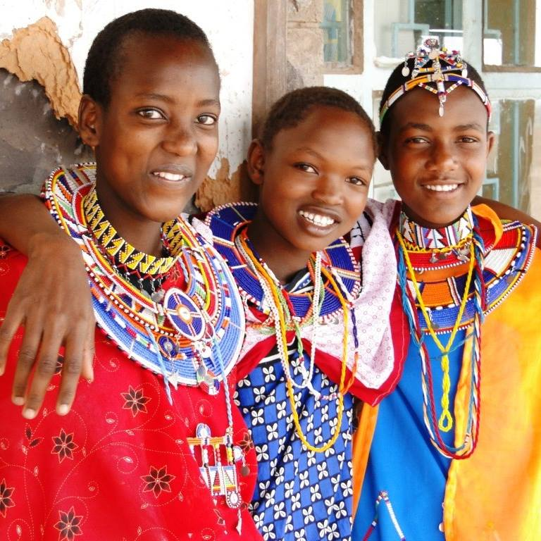
The Promise of CBNRM

Slide 27
The promise of CBNRM
In Namibia communal land conservancies have proliferated, and now cover more than 14% of the country, involve over 200,000 people and earn US$ 2.5 million per annum.
In Zimbabwe, CAMPFIRE generated $20 million in revenues for local communities and district governments from 1989 to 2001, and also resulted in over 40,000 km2 of communal land being managed for wildlife production.
In Tanzania, more than 3.6 million hectares of forests and woodlands are now managed as Village Land Forest Reserves, entirely under the control of locally elected village governments

Slide 28
The promise of CBNRM
In southern Kenya, 11,000,000 hectares is under communities that capture up to 1700 MtCO2e annually valued at US$126 million/yr.
In Cameroon, revisions to forestry law enabled community associations and cooperatives to acquire the exclusive rights to manage and exploit up to 5,000 ha of customary forest, under a 15-year contract, resulting in the creation of over 100 new Community Forests.
In Ghana, 200,000 hectares of forest have been demarcated under the Community Resource Management Area Policy of 2000.

Slide 29
CBNRM afford various benefits to communities and biodiversity
Example from the Masai Mara area of southern Kenya:
Economic – livelihood earnings (707, 460 HH), jobs (4,800), business, etc.,
142 tourism facilities, 2,397 bed capacity (2016)
$3.69 M in the Mara 2016 e.g., Olare-Orok Conservancy (Mara): $2,272 per landowner/year (2006-2008) to $2,714 (2009-2010) – payment for wildlife conservation
Social – bursaries, access to health facilities, roads, etc.,
Governance capacity – legitimacy, inclusiveness, adaptability, integration, accountability, etc. (Oduor, 2020).
Cultural - positive biodiversity outcomes (Said et al., 2012).
Notes:
BULLET #1
To start – what is natural capital? Natural capital is the world’s stock of natural assets – which include geology, soil, air, water, and all living things.
The benefits humans receive from this natural capital are vast – ranging from food and livelihoods to clean air and water to resilience to climate change and disease.
Because natural resources are finite, business leaders and policymakers must treat it like any other form of capital: failing to “spend it wisely” – as well as keep enough in reserve -- will inevitably diminish social, economic, and human well-being over time.
Traditional market assessments have looked valued nature only by the raw materials we extract – fish, livestock, honey, etc. But the avoided costs we enjoy as a society and economy when nature is intact and doing its job are also in the billions. This assessment was designed to assign an economic value to all of the services that nature provides, so that the public and private sector can make better decisions about how to steward our natural capital.
BULLET #2
We have been engaging policymakers, community leaders, researchers, and other stakeholders since April 2021 in reviewing and validating our data and providing input into an action plan. We are so pleased to have this opportunity to gain input from the private sector

Slide 30
Policy Actions
Establishing and promoting CBNRM offers the most scalable avenue to ensure wildlife habitats are secured, dispersal areas and migration corridors are established, and wildlife afforded protection.
CBNRM linked to payment for ecosystem services (PES) is considered a priority avenue to securing natural capital and building the regional economy.

Slide 31
THANK YOU

