Slide 1
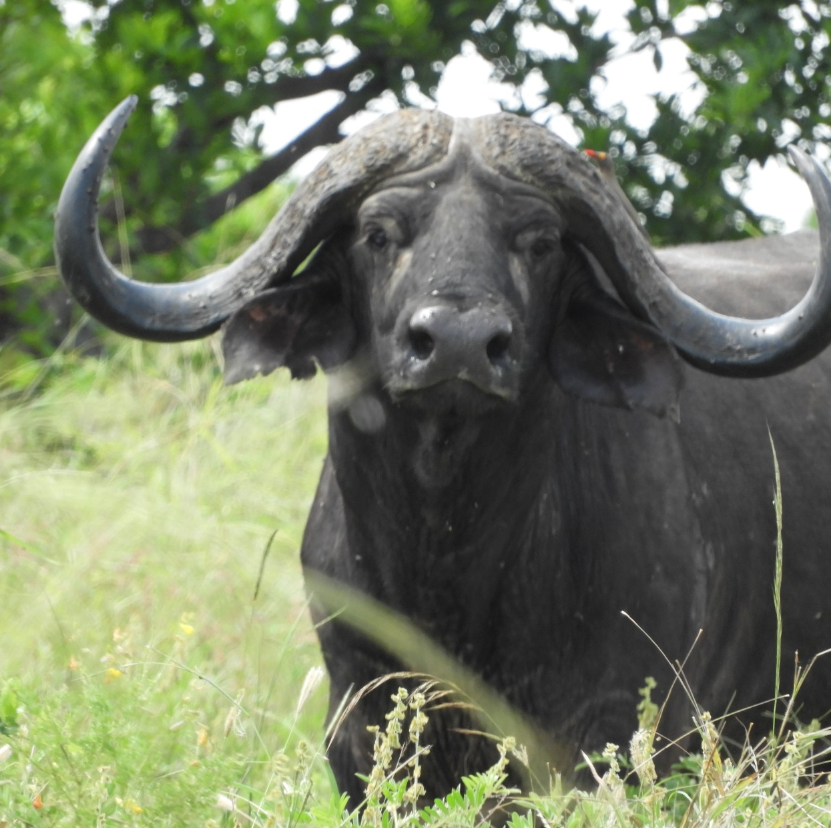
Bovine diseases in livestock and wildlife
Dr. Bernard Rono

Slide 2
Outline
Background
Introduction
Viral diseases – FMD, MCF, RVF
Bacterial diseases – Anthrax, Brucellosis, Bovine TB
Protozoan - Tick borne diseases

Slide 3
Introduction
Many pathogens can infect both domestic animals and wildlife
    With more than 77% of livestock pathogens known to infect multiple hosts including wildlife
Multi host pathogens can have significant consequences on livestock economics and wildlife conservation:
    high mortality and production losses in livestock
    In wildlife diseases can cause population decline, increased predation and reduced reproduction rates
Multi host pathogens provide a potential risk for disease emergence
Notes:
Diseases can have consequences on international trade in animal and animal products, food security
These pathogesns affect the

Slide 4
Intro..
Understanding disease transmission dynamics at the wildlife/ livestock interface is critical in designing control strategies:
    For certain pathogens wildlife can act as reservoirs
    Conversely, domestic animals can act as maintenance hosts for pathogens,
Climate change, population growth and human development have significant impact on the interface
Here we review important bovine diseases at the wildlife/ livestock interface
Notes:
For certain pathogens wildlife can act as reservoirs, which when transmitted to livestock can rapidly spread
Conversely, domestic animals can act as the reservoir for pathogens, which may not be independently maintained, in fragmented populations of wildlife

Slide 5
Introduction
Viral diseases
Bacterial diseases
Vector borne diseases

Slide 6
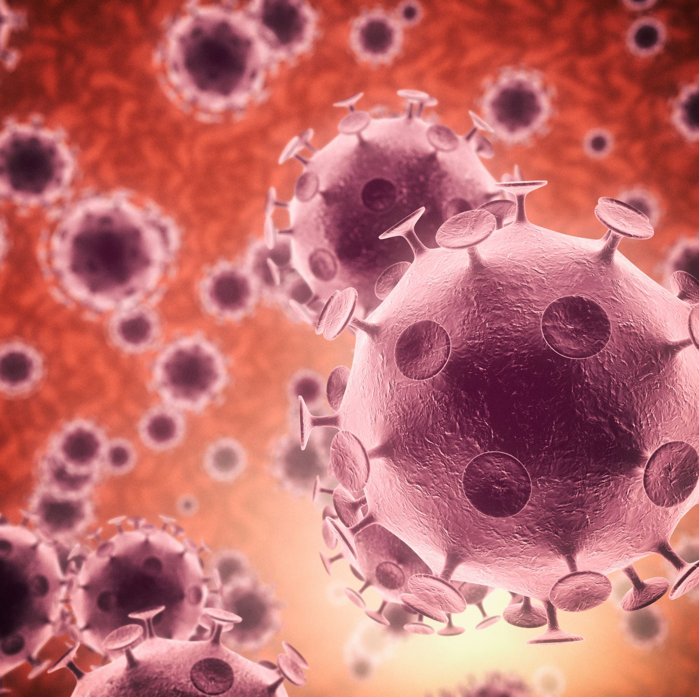
Viral disease

Slide 7
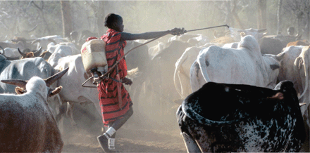
1. Rinderpest
    Status: Eradicated globally
    Declaration made on 27th May 2011 at OIE 79th World Assembly in Paris
    2nd disease to have been eradicated
    Viral disease of cattle and wild ruminants thought to have originated from Asia
    Caused devastating epizootics in the late 19th century
    Driven to Extinction, J. Science Volume: 319, Issue: 5870,

Slide 8
Impact of Rinderpest outbreaks
  High mortality of cattle and loss of livelihood
  Decimated wild populations of buffalo, giraffe, wildebeest, antelopes
    In 1990s outbreak, 60% of buffalo population died in Tsavo ecosystem
    Endangered Roan antelope population
  altered ecological balance by reducing number of grazers
    Grassland turned into thickets, proliferation of tsetse fly

Slide 9
2. Foot and Mouth Disease
Extremely contagious acute viral disease of domestic and wild cloven hoofed mammals
    Endemic in Kenya with outbreaks reported in many parts of the country
7 distinct serotypes: O,A,C and Asia 1 and SAT 1,2,3
    Buffalos are reservoirs of SAT 1, 2 and 3 serotypes
    Only SAT 1 and 2 have been isolated in Kenya
Recent evidence suggest that transmission of FMDV between buffalo and cattle is rare
    Outbreaks of disease occur through maintenance in cattle population
    George Omondi et al., 2020. Transboundary and Emerging Diseases
Notes:
Some countries have managed to eradicate the disease by slaughter of affected herds, but this is not practical where we have natural reservoirs

Slide 10
Impact of FMD
High mortality and production losses
Affects international trade in livestock and livestock products
High cost of control
    Effective vaccines are available

Slide 11
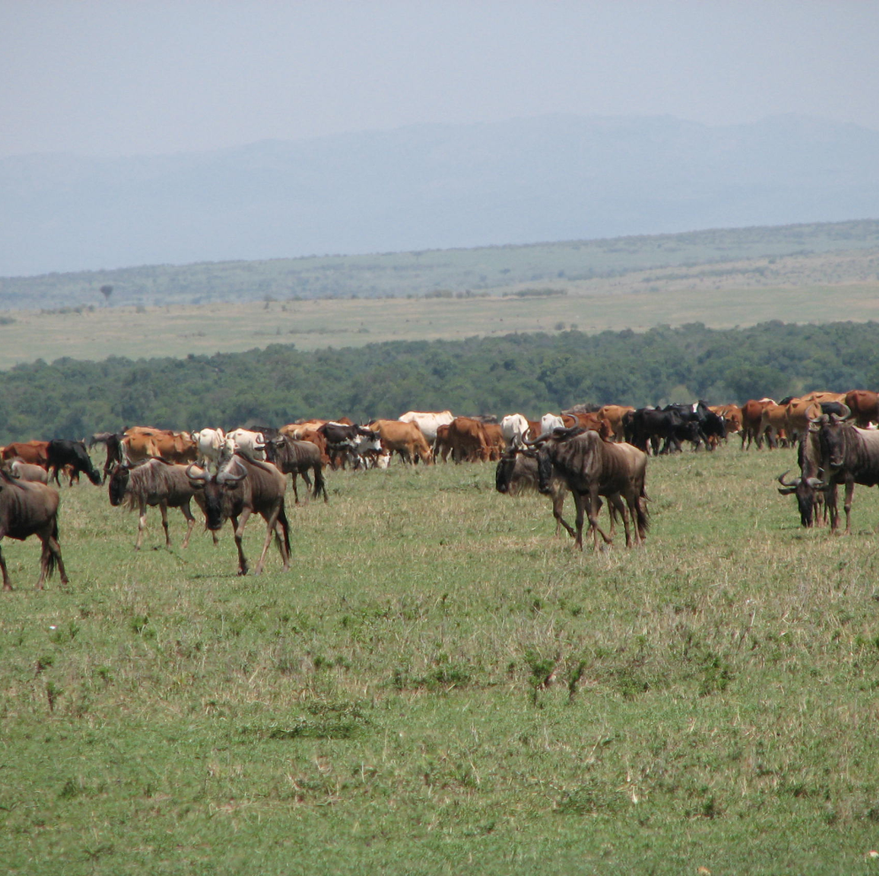
3. Malignant catarrhal fever

Slide 12
Malignant catarrhal fever
Fatal lymphoproliferative disease of cattle and other ungulates
    Alcelaphine Herpesvirus-1 (AlHV-1) and Ovine Herpesvirus-2 (OHV-2)
Wildebeest are reservoir host of AlHV-1
    Cattle contact the virus from wildebeest calves which shed the virus,
Wildebeest associated MCF mainly occur in southern Kenya, northern Tanzania and southern African countries
    Peak transmission occurs during calving season which coincides with wildebeest migration

Slide 13
Impact of MCF
High mortality and production losses in cattle
Causes human – wildlife conflict
    Diseases prevents community access to wildebeest grazing areas
    Hinders development community conservancies and wildlife migration corridors
There is no effective vaccine or treatment for MCF
Effective control of the disease can be achieved through development of effective vaccines

Slide 14

Bacterial diseases

Slide 15
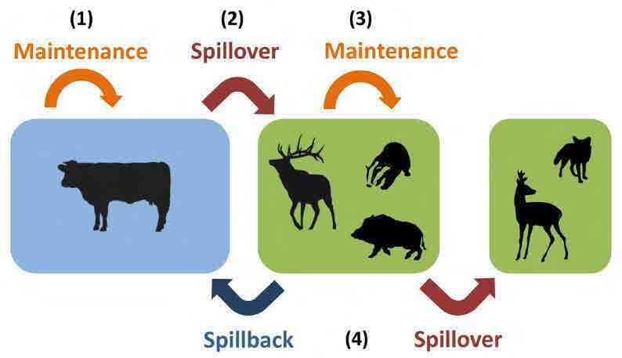
1. Anthrax
Acute highly contagious disease of domestic and wild herbivores
  Caused by spore forming Bacillus anthracis, spores persist in soil
  Humans, suids and carnivores are incidental hosts
Status: endemic in many conservation areas in Kenya
  Threatens endangered wildlife population
Ryser-Degiorgis, M. 2015

Slide 16
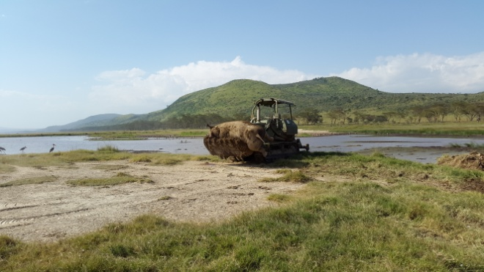
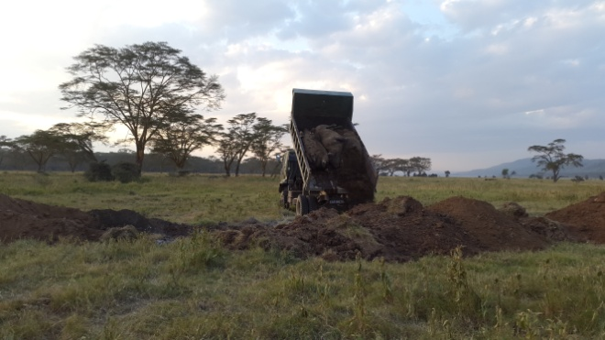
Control of anthrax in wildlife
Aim to break anthrax transmission cycle through
Proper carcass disposal – bury with calcium hypochlorite
Decontamination of carcass sites
Vaccination of endangered species? – technical and logistical challenges
Notes:
Vaccination, proper carcass disposal, environmental decontamination

Slide 17
2. Brucellosis
Bacterial zoonotic disease with worldwide spread caused by Brucella spp.
    Consist of six species, Brucella abortus causes disease in bovine
A recent study in Kenya showed that of 16 wildlife species sampled ,
      three species had antibodies to brucella
      Overall sero-positivity of 13.7%
      Buffalo had the had the highest proportion positive at 22%
Transmission to humans is through contact with fetal material of infected livestock and consumption of raw milk

Slide 18
Impact of the disease
Listed among top 5 priority zoonotic disease in Kenya
In humans upto 500,000 new cases are reported annually in developing countries
There is no effective vaccine in humans and no treatment in animals

Slide 19
Other examples
Bovine tuberculosis
Tick borne diseases –Crimean congo hemorrhagic fever
Bat associated viruses

Slide 20
General Interventions
Vaccination:
Managing disease in reservoir host –
Minimizing contact with alternative host
Notes:
control of rinderpest in cattle led to eradication of disease in wildlife

Slide 21
Conclusion
There is a need to understand disease dynamics in complex ecosystems to mitigate disease threats
A multi disciplinary, multi sectoral One Health approach is vital in studying disease dynamics at the livestock/wildlife interface
Notes:
Including public health

Slide 22
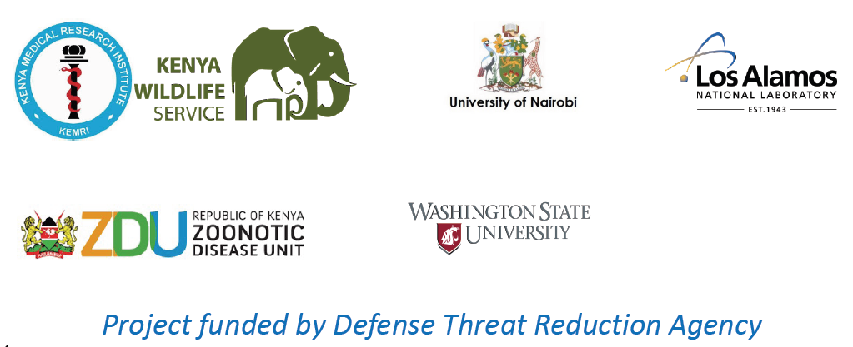

Acknowledgements

Slide 23
KWS veterinary department
Wildlife Health programs
  Clinical interventions
  Disease surveillance and control
  Wildlife rescue
Species management programs
  Population management – translocations
  Wildlife monitoring technologies – e.g telemetric collars,
  Assisted reproductive technologies
Research

